Slide 1

FS105 CAPSTONE PROJECT
Full E-commerce Website
Notes:
Kannan

Slide 2

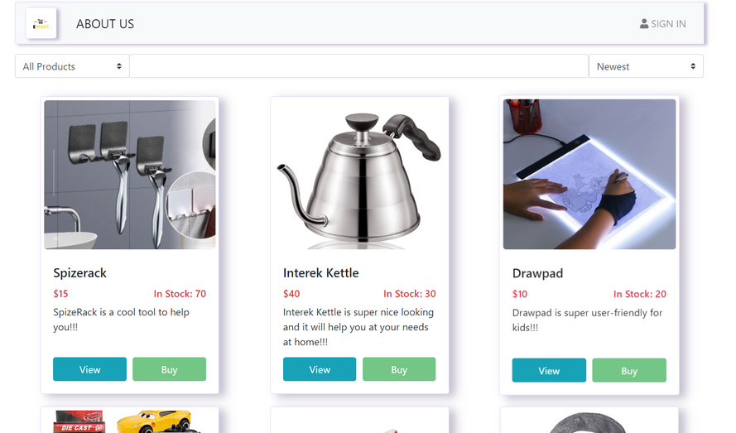
About E-Mart
E-Mart is a constantly evolving technological infrastructure which connects this vast & diverse region and offers Singapore a shopping experience that is safe, seamless, and enjoyable.
E-Mart lifestyle redefines the boundaries of retail, delivering engaging and entertaining experiences customized to each of our markets. Discover the world at your fingertips on E-Mart.
Notes:
Kannan

Slide 3
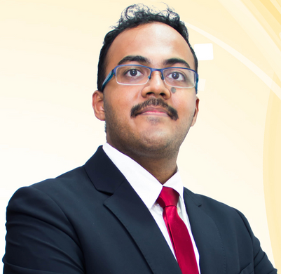


Team Lead
Front End and Back End integration
and design
GROUP CONTRIBUTIONS
Back-end Developer
Backend initial design, Product
catalogue and API testing
Team Members
Business Coordinator
Testing, Documentation, Business Flow and Template creation
for notification
Notes:
Kannan

Slide 4

Problem Statement
Proposal
Scope
AGENDA
Summary & Milestone
User Stories & Business Flow
Challenges & Deployment Process
Learning Experience & Next Steps...
Notes:
Kannan

Slide 5
Problem 1
Have issues keeping track of all the orders
PROBLEM
STATEMENTS
Problem 2
Cannot manually keep track of the inventory movement
Problem 3
Have problems managing and maintaining customer database
Notes:
Kannan

Slide 6
User Authorization to create user profiles with registration and login
OUR
PROPOSAL
Admin Profile for CRUD operations on product data and inventory management
Product Catalogue for normal user
Create a full working and functional Application (from Frontend to Backend) with User Profile and Admin accounts for an Online Shopping Website
Checkout and pricing options for normal user
Filters option for Product Types for normal user
PITCH DECK V 1.0
Inventory management for parallel usage
Notes:
Kannan

Slide 7
Work on an application which will serve the purpose of E-commerce for a shop with Online cart, check out option and inventory management for admins.
OUR
SCOPE
The application is readily available for anyone to sign up and use (It is not exclusive)
PITCH DECK V 1.0
Notes:
Kannan

Slide 8

Research
SOLUTION APPROACH
Identify Knowledge Gap
Refactor & Improvise
Develop
Notes:
Kannan

Slide 9
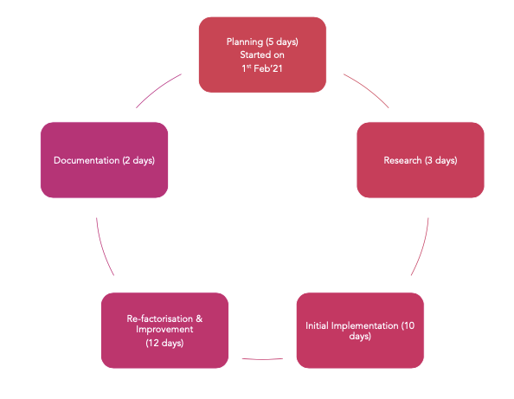
STORIES TIMELINE
Notes:
Kannan

Slide 10

SIGN-UP
Scan now
Notes:
Ibnu

Slide 11
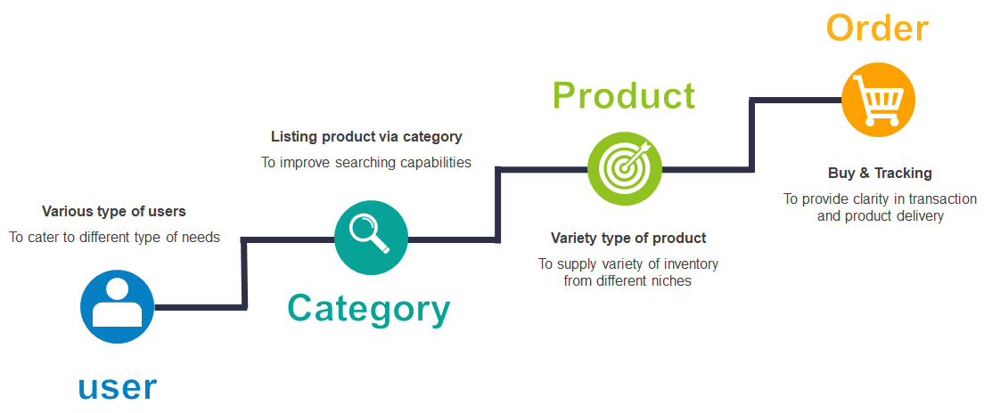
BACK-END
MODELS
Notes:
ibnu

Slide 12
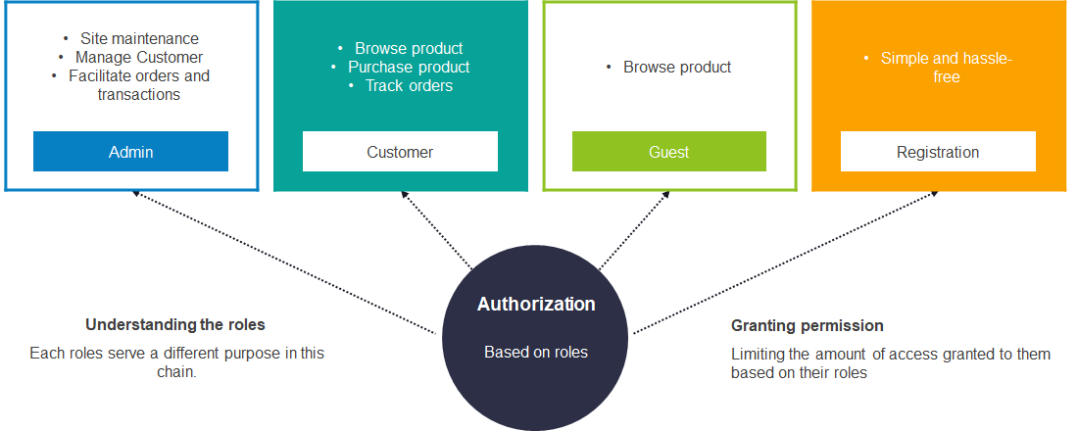
ROLES &
PERMISSIONS
Notes:
Ibnu

Slide 13
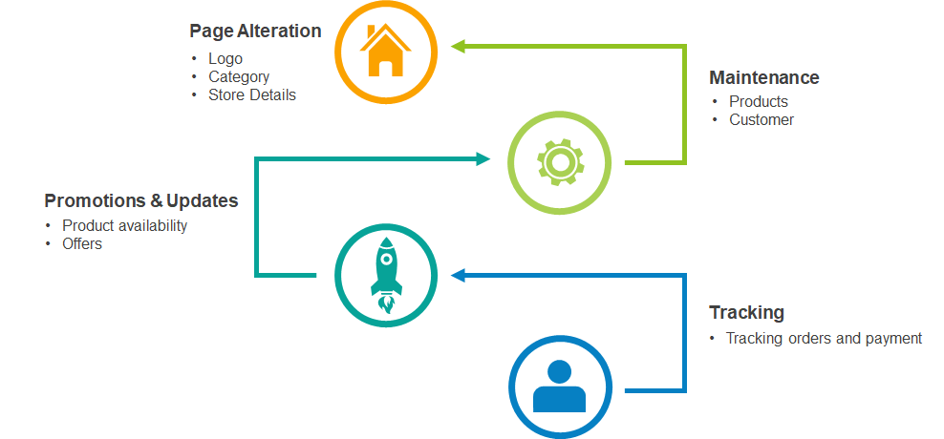
ADMIN
Notes:
Siew Woon

Slide 14
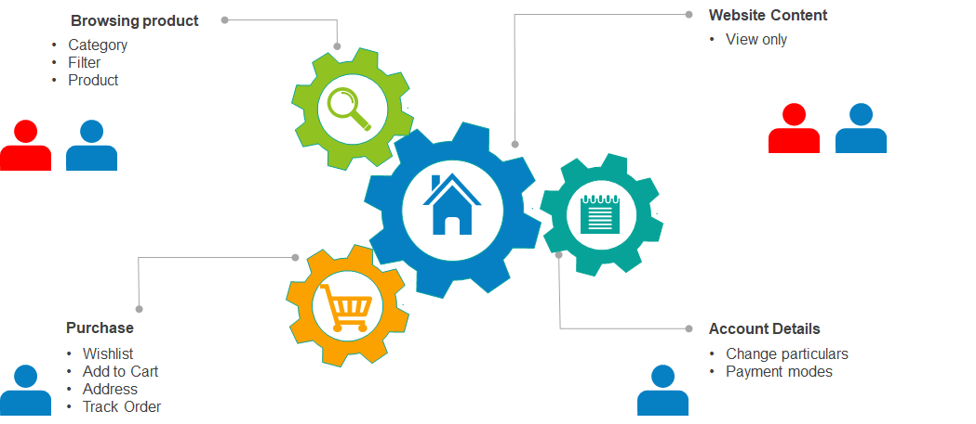
CUSTOMER
& GUEST
Notes:
Siew Woon

Slide 15
1.9 Billion
Performance due to
upload sizes
1.9 Billion
CRUD operation was
not easy to implement
CHALLENGES
And why we shiftd
Image uploading was
not straightforward for
multiple images
1.9 Billion
Session handling
User Privileges integration with Front end was not
easily scalable
Notes:
All of us

Slide 16
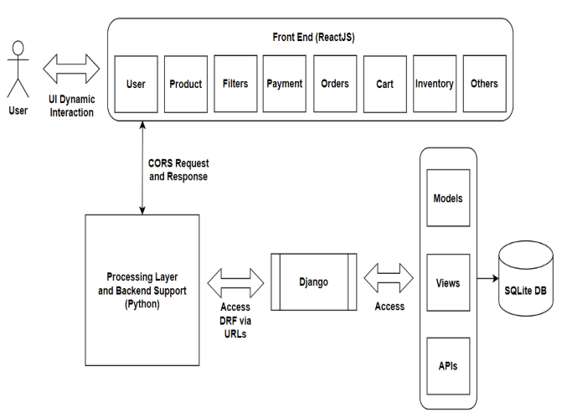
SELECTED STACK
(INITIAL STATE)
ReactJs for Frontend
Django for Backend (DRF)
Notes:
Kannan

Slide 17
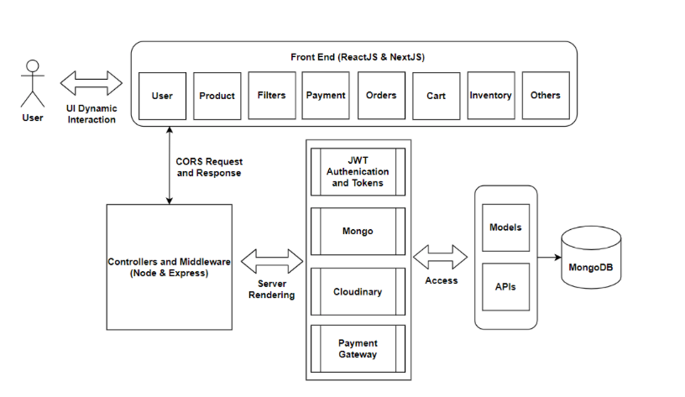
SELECTED STACK
(FINAL STATE)
ReactJs and NextJs for Frontend
MongoDB, Cloundinary and Express for Backend
Package via Node
(So mainly MERN)
Deployment via Vercel Hoisting Platform
Notes:
Kannan

Slide 18
LIVE CHAT
NEXT
STEPS...
STAFF CONSOLE
SWITCH THEMES

Slide 19
BUSINESS IDEAS
LEARNING EXPERIENCE
FRONT-END
BACK-END
Notes:
All of us

Slide 20
Q&A
Thank you

Slide 21
For Hiring
Contact Us
kannanazhagappa@gmail.com
ibnuirfan09@gmail.com
siewwoon.lee@gmail.com

